Slide 1
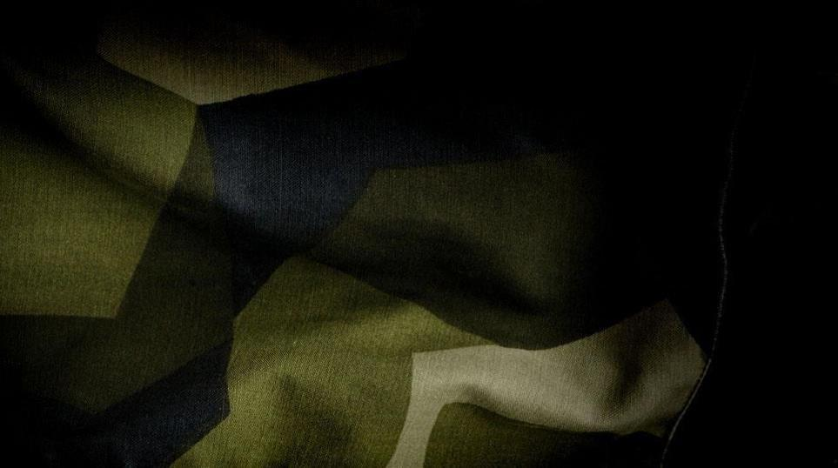



Swedish new model army perspective of the evolution
DEP. DIR FORCE PRODUCTION
SWEDISH ARMY
lt COL Niklas Tornesjö

Slide 2
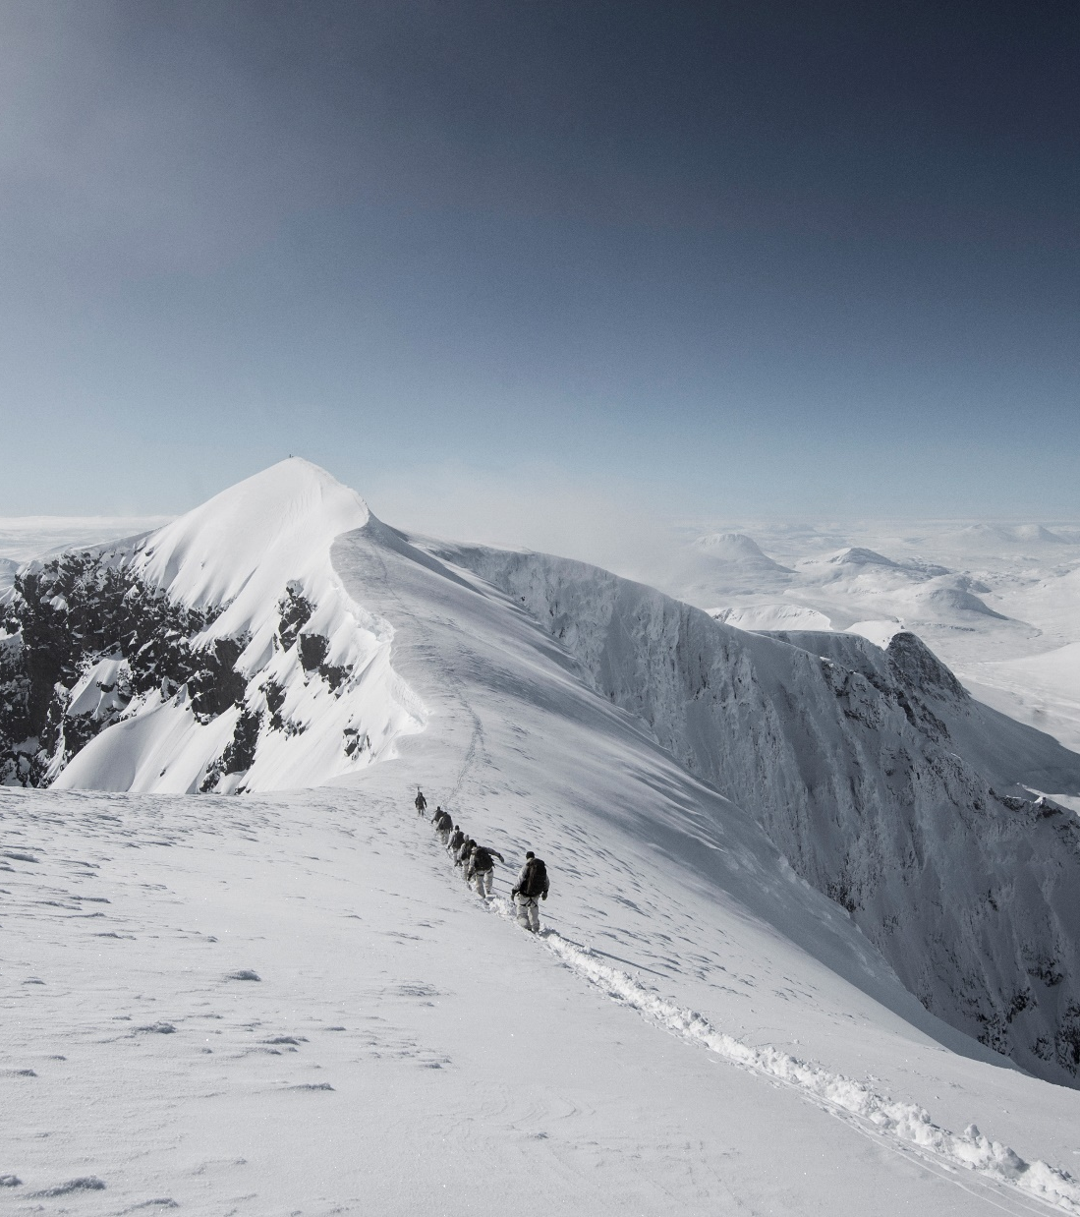
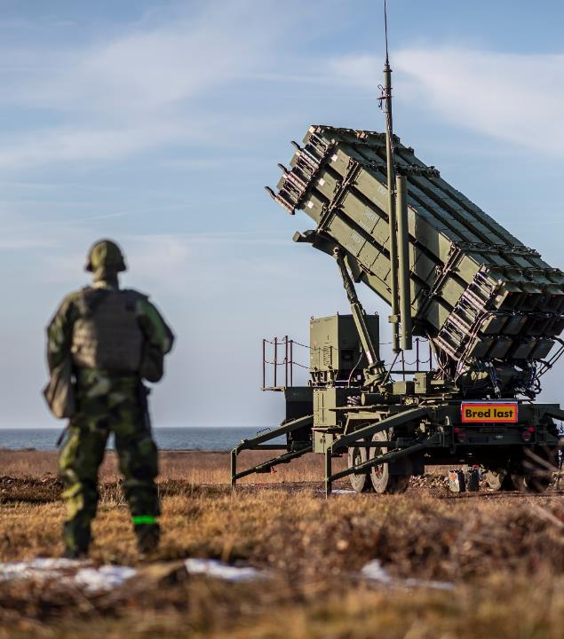

Historical outlook
Swedish Army in NATO
Swedish conscript system
Agenda

Slide 3
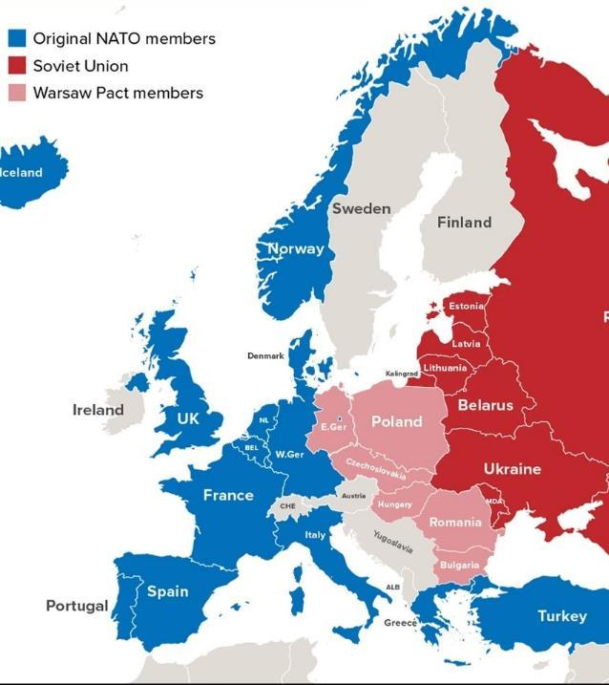
Historical outlook cold war – traditional focus
north
Distancing (neutrality)
Total defence
Conscript army
south
XX

Slide 4
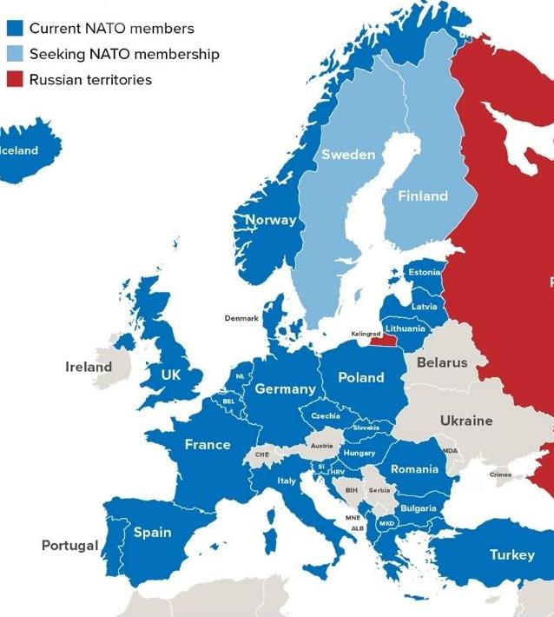
Historical outlook expeditionary ERA
Hedging/multiple courting & bandwagoning
Expeditionary force
Active duty army

Slide 5
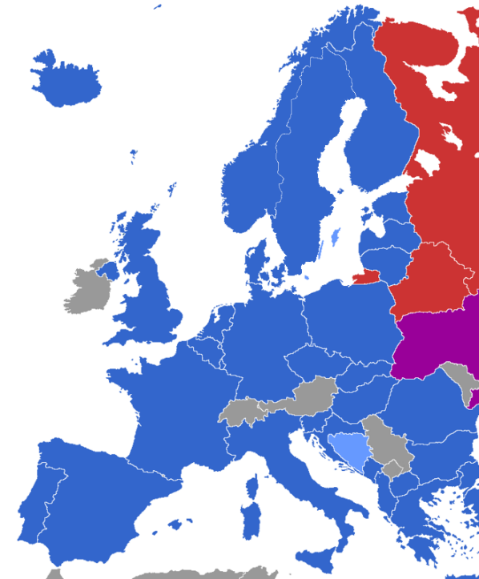
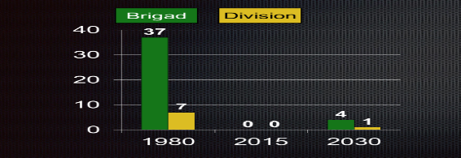

Swedish army in nato overview – THE NEW SWEDISH ARMY MODEL
NATO allied strategy (article 3 & 5)
Total defence
Active duty & conscript army
Organic transformation
Brigade
Division

Slide 6

Swedish army in nato new perspective
DEEP/ rear
REAR/Deep
CLOSE /
CLOSE

Slide 7
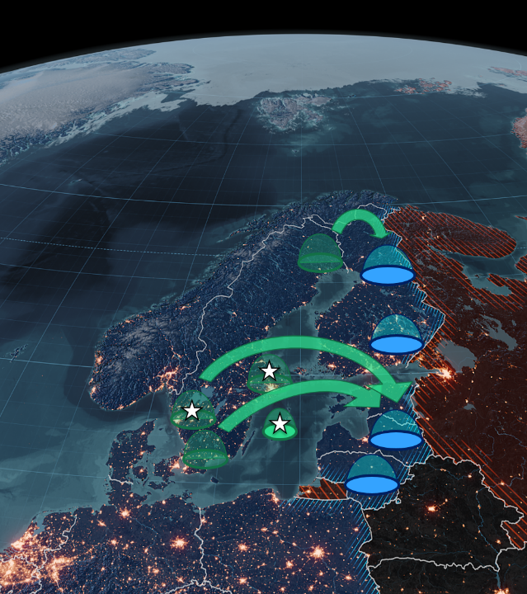
Swedish army in nato management mental transformation

Slide 8
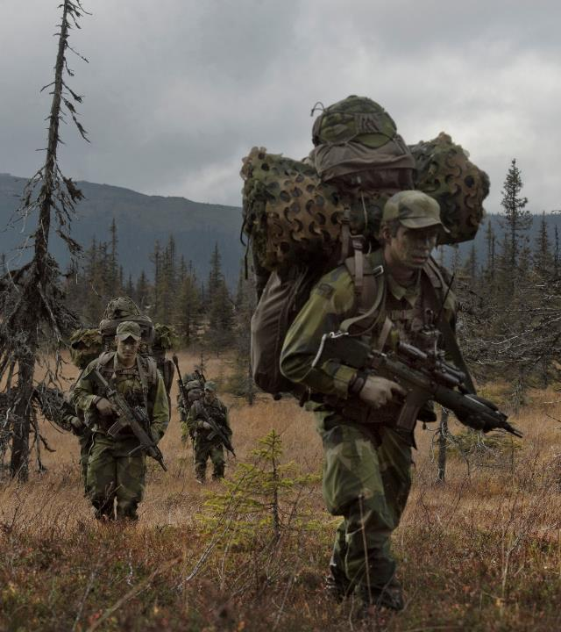
Swedish conscript system
Draft and selection of conscripts
Conscript Private
Conscript Squad leaders
Conscript platoon sergeants

Slide 9
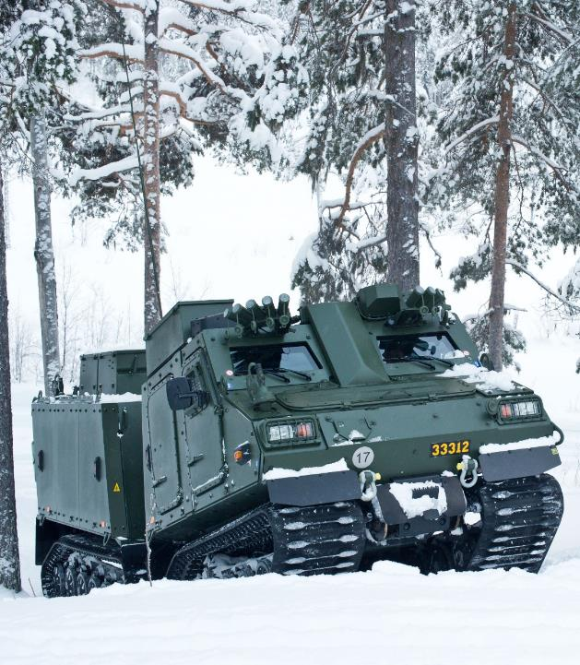
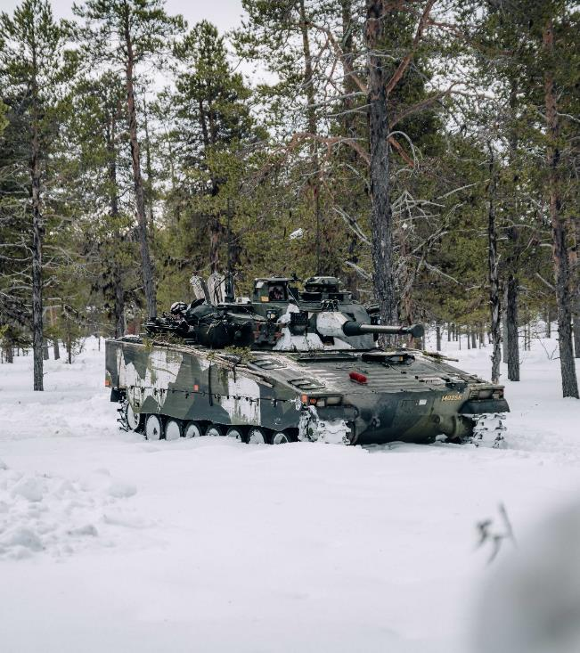

Thank for listning

